Slide 1
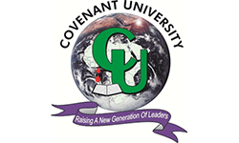
PHYSICAL REHABILITATION AND CLASSIFICATION OF MOTOR IMPAIRMENTS
USING IOT AND MACHINE LEARNING APPROACH
Presented By
Amadi Chukwudimma Lawrence
16CK020878
Electrical & Information Engineering
Information & Communication Engineering
Ogbonna Chukwudi Ajaero
16CJ020749
Electrical & Information Engineering
Computer Engineering
Supervised By
Professor Misra Sanjay & Mrs. Comfort Lawal

Slide 2
Introduction
Presentation Outline
Review of Related Works
Problem Statement
Aim & Objectives
Points for discussion
Materials & Methods
Results
Challenges & Limitations
Recommendation & Conclusion
References

Slide 3
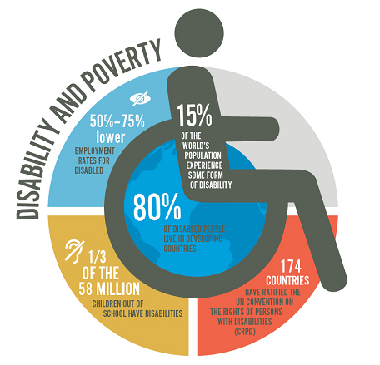
INTRODUCTION
Disabilities: World \ Africa Statistics
According to World Health Organization and the World Bank, more than a billion people in the world today experience disability – about 15% of the world’s population
According to the United Nations, about 40% of the population in Africa live with disabilities. This is about 80 million people, of which Nigeria has 25 million.
The most common disability type is mobility.

Slide 4
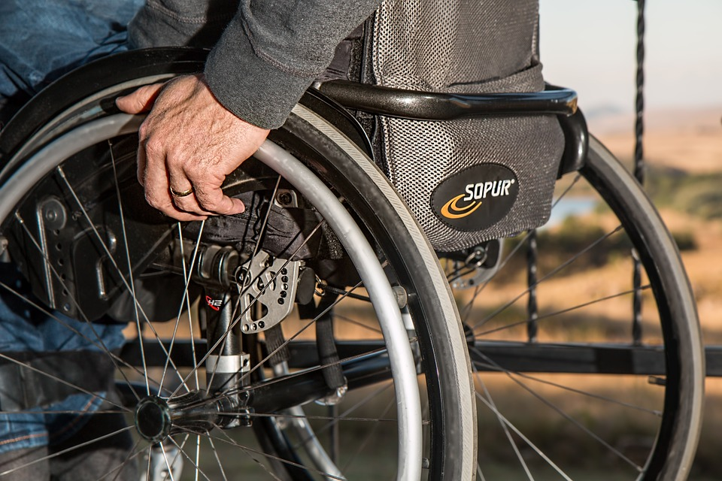
INTRODUCTION
Motor Impairments & Its Causes
Motor impairment is the partial or total loss of function of a body part, usually the limb(s).
Major causes include accidents, muscle weakness, poor stamina, lack of muscle control, partial or total paralysis.
Some examples are conditions such a cerebral palsy, Parkinson’s disease, stroke, etc.

Slide 5
The ways of solving using tech
Limitations of tech – especially in developing countries
The use of assistive technology like mobility aids such as;
Wheelchairs
Assistive Canes
Walkers
Crutches
Adaptive Keyboard, etc.
Lack of appropriate training and support.
Difficulties in procuring and managing equipment.
Poverty / lack of resources
Thus, the need for a cheaper solution

Slide 6
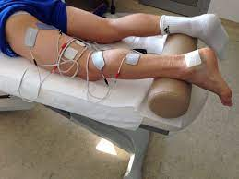
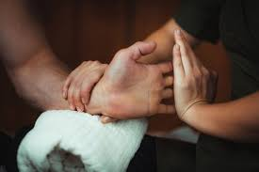
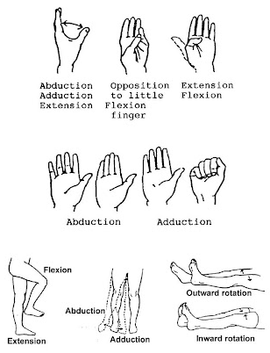
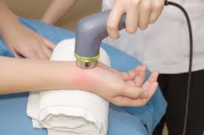
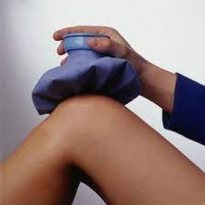
Background – Physiotherapy Approaches
Electrotherapy
Soft Tissue Mobilization
Range of Motion (ROM) Exercises
Therapeutic Ultrasound
Heat Therapy
For high accuracy of assessment, ML is introduced

Slide 7
Background – Machine Learning
SUPERVISED LEARNING
UNSUPERVISED LEARNING
REINFORCEMNET LEARNING
It is a category of machine learning that deals with using labeled datasets to train algorithms to classify data.
It is a category of machine learning that deals with using unlabeled datasets to train algorithms to classify data.
It is the category of machine learning that deals with training of our models to make sequence of decisions in a state space environment.
Examples include K-NN, SVM, Decision Trees, etc.
Examples include K-Means Clustering, Gaussian Mixture Model, etc.
Examples include Q-Learning, SARSA Learning, etc.

Slide 8
Review of Related Works
Title of Work | Year | Approach | Gap(s) | IoT | ML | Cost
Classification of Ischemic Stroke using Machine Learning Algorithms | 2016 | Machine Learning Used self-reported data, CT & MRI scans | Model can only classify types of Ischemic Stroke Does not aide rehabilitation | No | Yes | Moderate
SoPhy: A Wearable Technology for Lower Limb Assessment in Video Consultations of Physiotherapy | 2017 | Embedded sensors Real-time assessment of weight distribution, foot movement & orientation over web interface. | Focused only on lower limb assessment Rehabilitation progress cannot be ascertained. For use only for video consultations. | Yes | No | Moderate
Physical rehabilitation based on smart wearable and virtual reality serious game | 2019 | IoT Virtual Reality Serious Games | Focused only on upper limb rehabilitation | Yes | No | Expensive

Slide 9
Review of Related Works
Title of Work | Year | Approach | Gap(s) | IoT | ML | Cost
Real time monitoring system for upper arms rehabilitation exercise | 2015 | Embedded Sensors Real time assistance from physio-therapists | Focused only on upper limb assessment Physio-therapist assistance required | Yes | No | Moderate
Design of Smart Portable Rehabilitation Exoskeletal Device for Upper Limb | 2016 | Robotic Device Assists range of movements of the upper limbs during rehabilitation exercises | Focused only on upper limb assessment Mechanical devices are quite heavy. Poor speed control can lead to complications. | Yes | No | Expensive
Machine Learning algorithms activity recognition in ambulant children and adolescents with cerebral palsy | 2018 | IoT ML algorithm to classify type of activity performed | Only accounted for the type pf activity, Rehabilitation was not performed. | Yes | Yes | Moderate

Slide 10
Disability statistics are on the rise due to ageing process, population growth and medical shortcomings.
Traditional exercises and technological approaches in rehabilitation are either too expensive or difficult for physiotherapists to objectively track, measure and monitor patients' progress & recovery status.
Many of the exercises and activities included in the programs are monotonous. Thus, do not motivate patients to perform to their full potential.
Problem Statement

Slide 11
Aim Objectives
The objectives to actualize our aim include:
Design and implementation of an IoT wearable system architecture for the upper and lower limbs.
Acquire and store datasets of measured force, flexion and motion for varying motor impairments.
Develop a prediction model for classifying motor impairment using machine learning algorithms.
Test the developed system to check its adherence to expected results.
This project aims to develop a physical rehabilitation and classification system for motor impaired patients using IoT and machine learning approach.

Slide 12
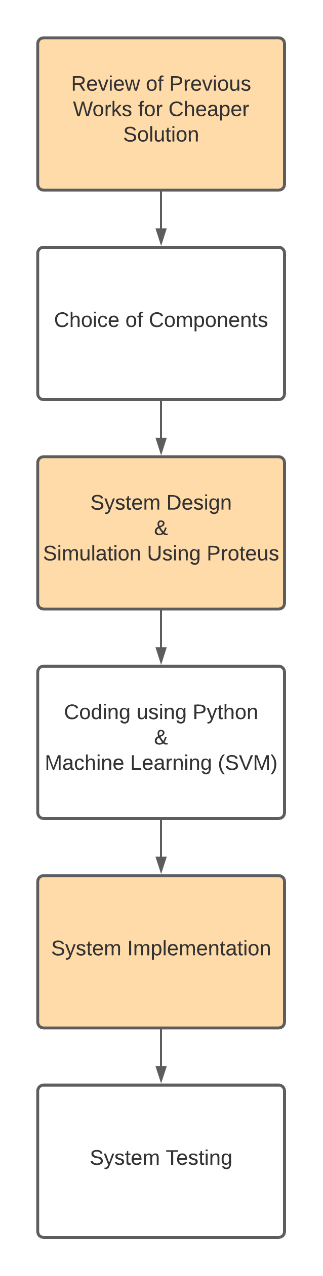
Materials & Methods – Flowchart

Slide 13
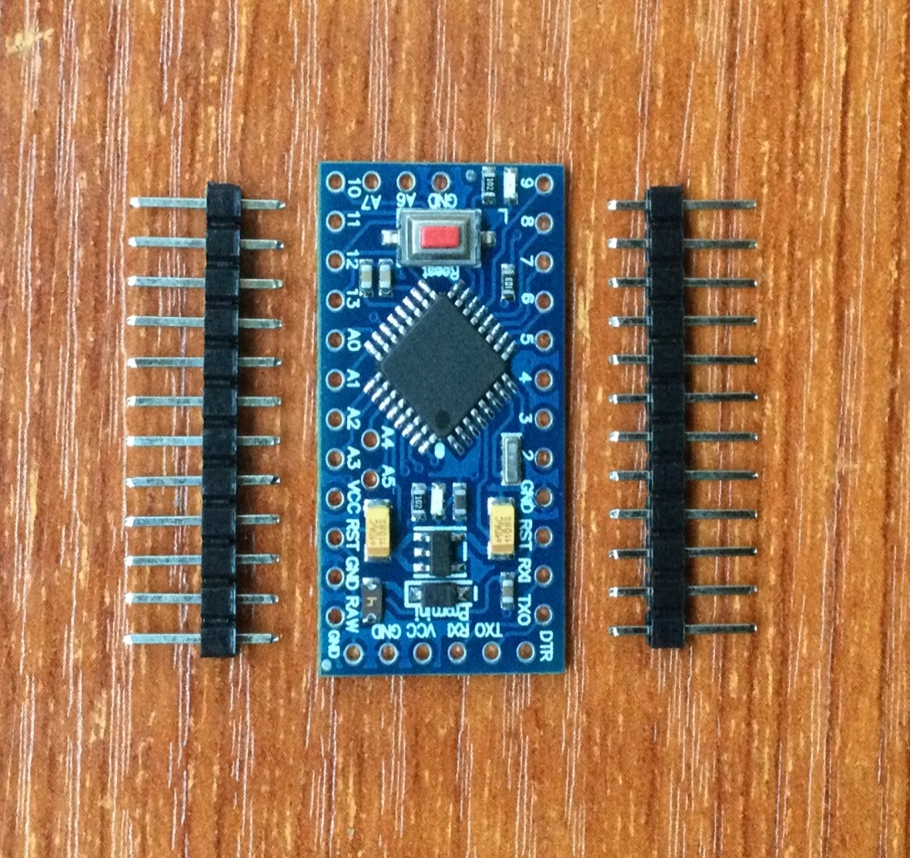
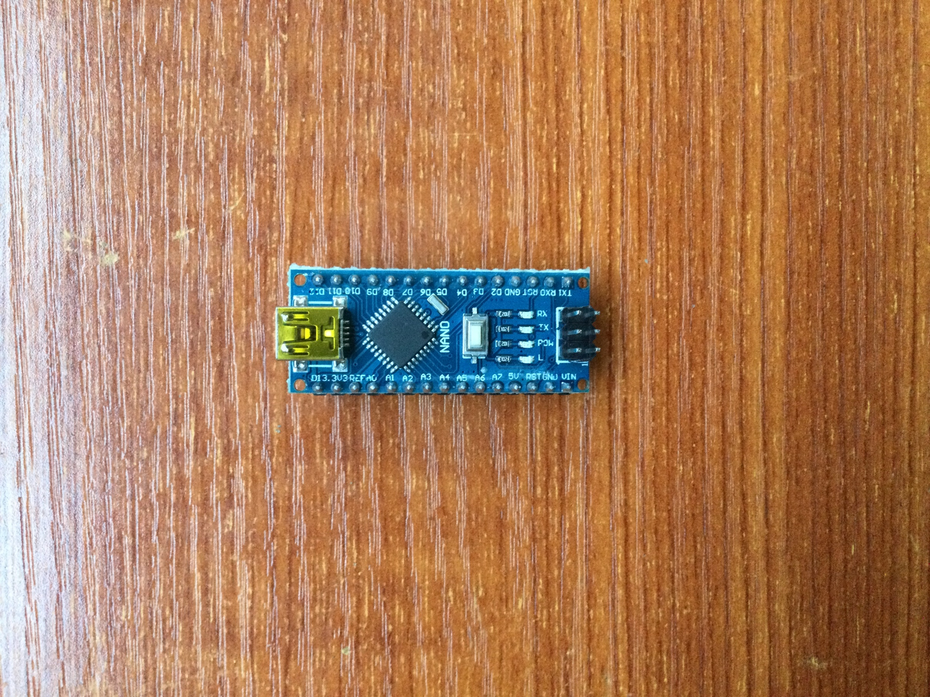
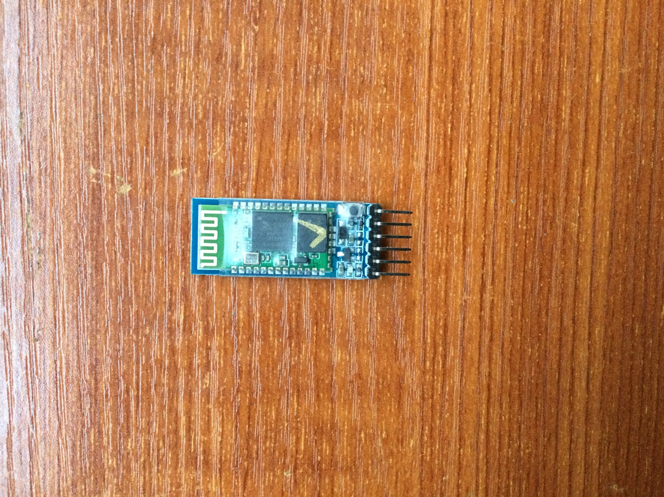
Materials & Methods – Hardware Components
Arduino Nano
Arduino Pro-Mini
Bluetooth Module HC-05
Cheaper solution, smaller in size and less bulky and consumes lesser power than the Nano.
Consumes less power than a WiFi module.
Easy to setup.
Seemingly small
Cheap alternative.

Slide 14
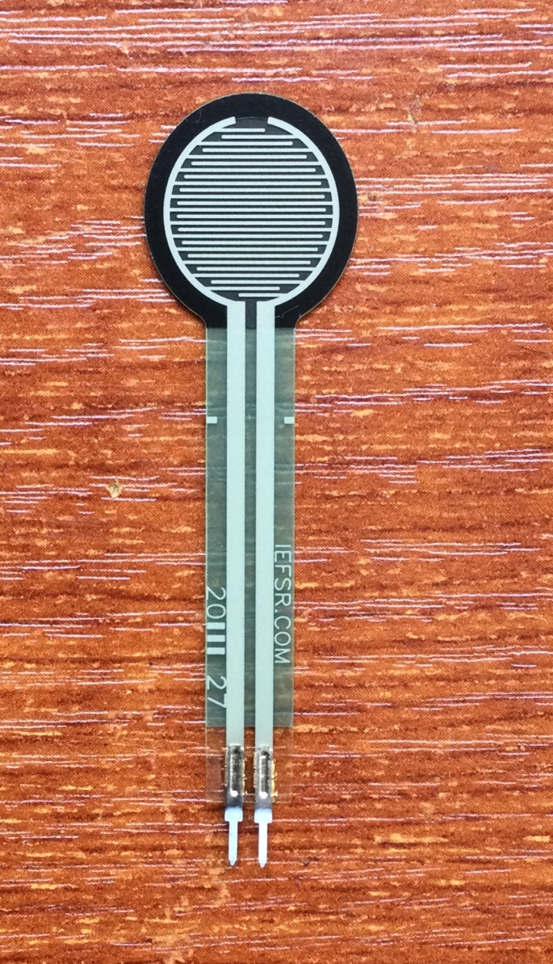
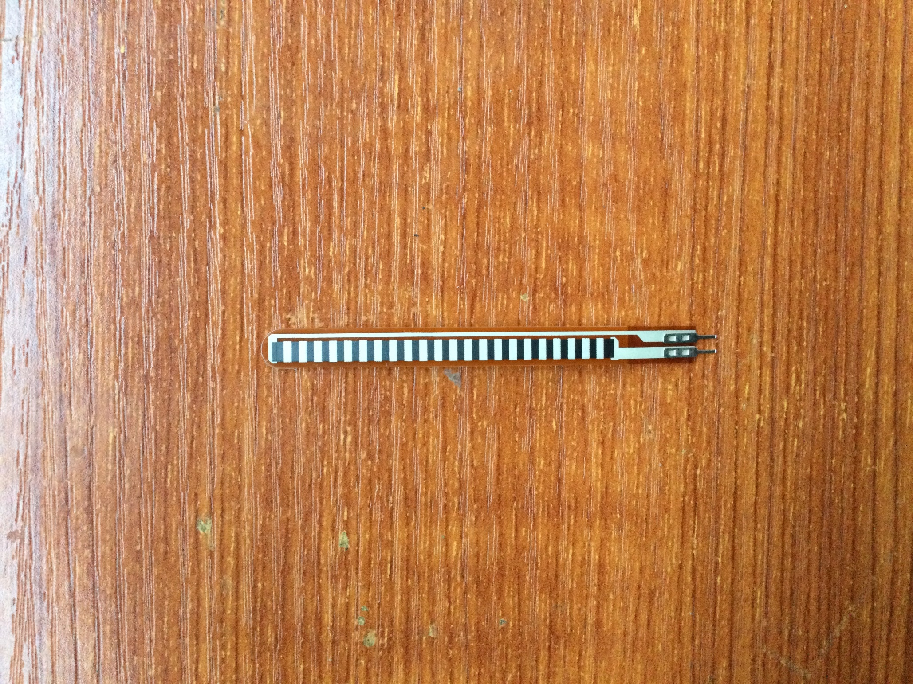
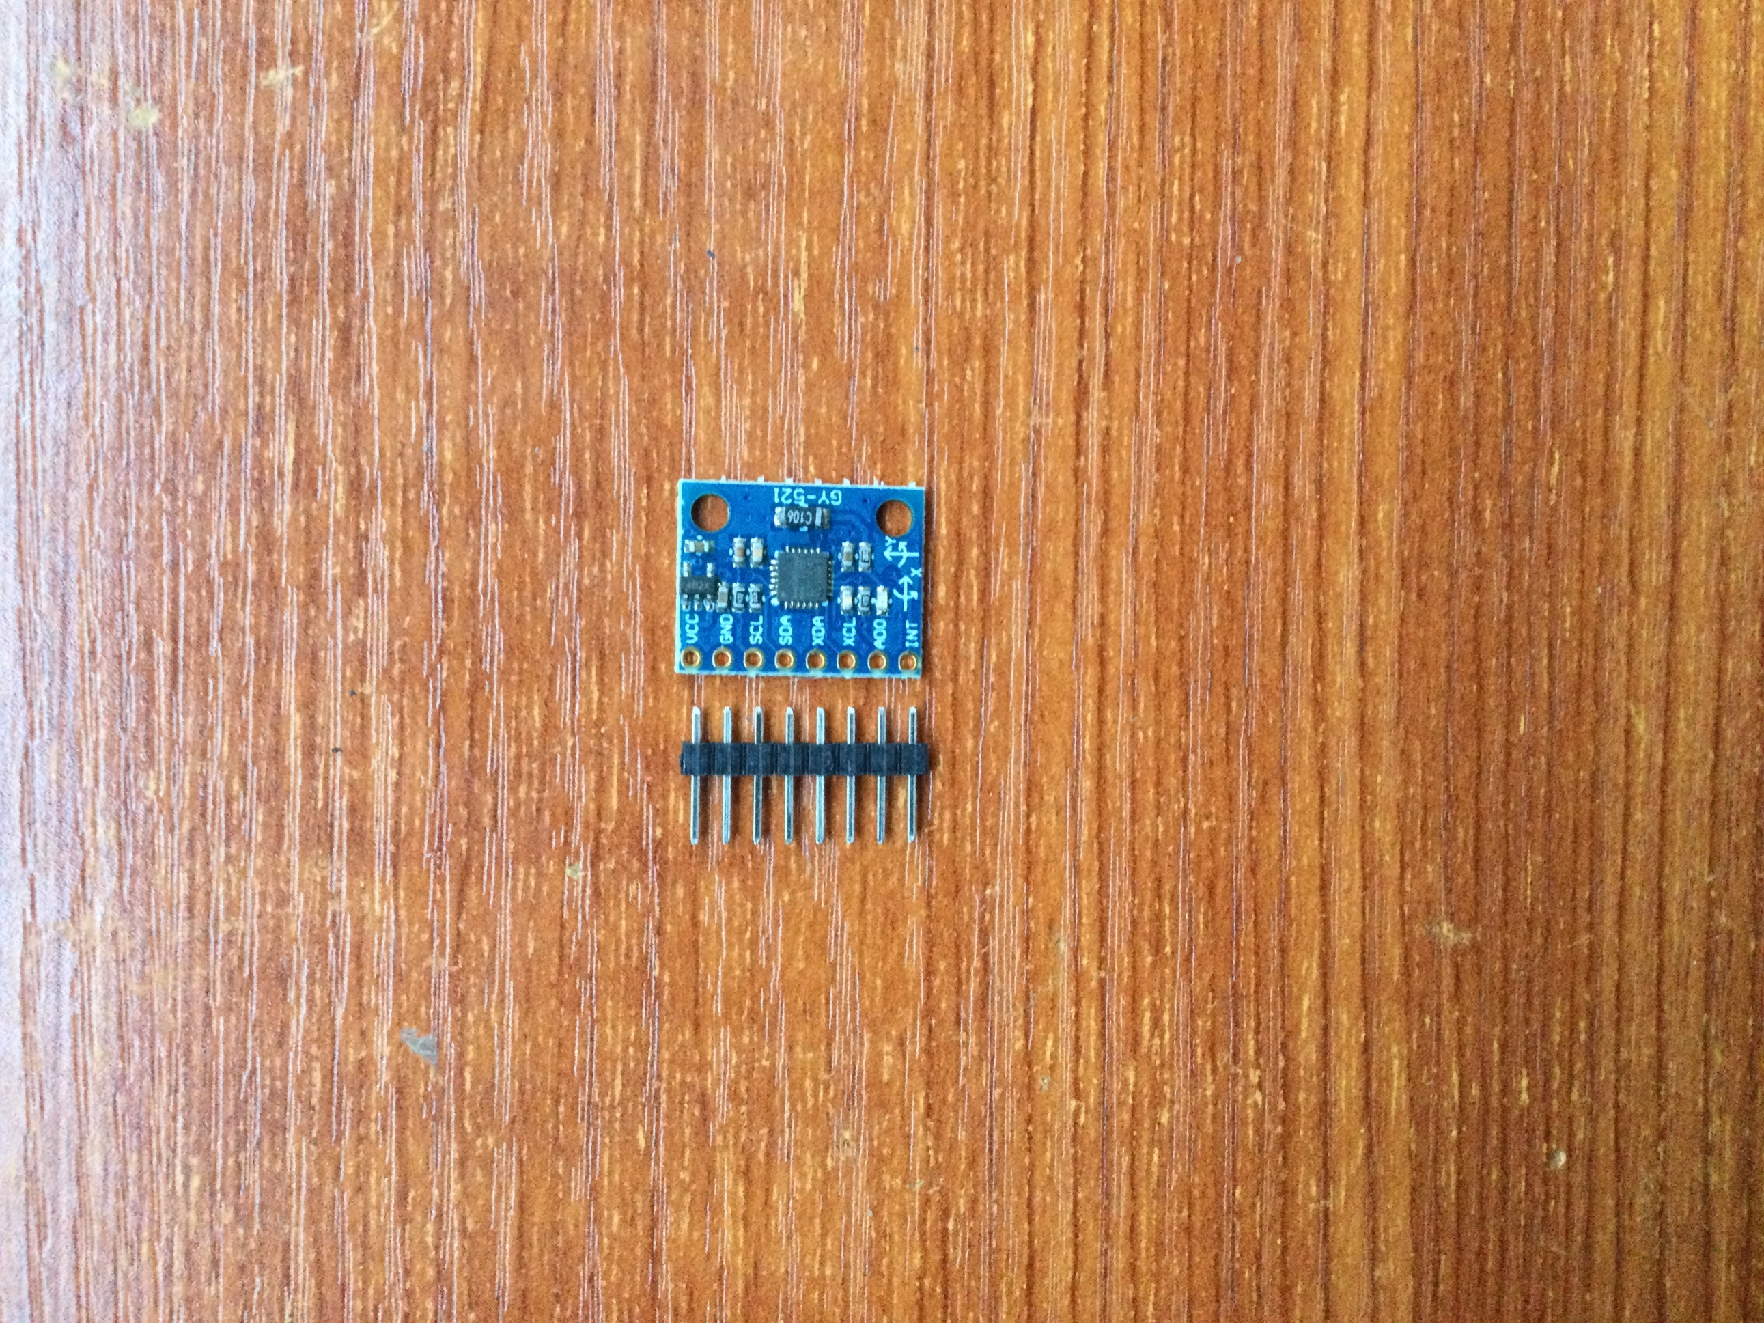
Materials & Methods – Hardware Components
Adafruit Short Flex Sensor (ADA1070)
Force Sensing Resistor (FSR-402)
They are 2.2” in length – averagely same length with fingers
Measure bend in one direction
Ultra thin
Actuation force as low as 0.1 N and sensitivity range to 10 N
Cost effective
3-axis accelerometer and gyroscope
For precision tracking of both fast and slow motions
Inertial Measurement Unit (MPU-6050)

Slide 15
PyCharm
Materials & Methods – Software
PyCharm is an integrated development environment used in computer programming for the Python language.
Python Kivy
Kivy is a free and open source Python framework for developing mobile and desktop apps with a natural user interface
Scikit Learn
Briefly mentioned are some of the software tools utilized in the completion of this project
Scikit-Learn is a free software machine learning library for Python programming language

Slide 16
Precision Recall F1-Score Support
Arthritis 1. 00 0. 78 0. 88 9
Cerebral Palsy 1. 00 1. 00 1. 00 4
Left Side Stroke 0. 75 1. 00 0. 86 3
None 1. 00 1. 00 1. 00 2
Parkinson Disease 1. 00 1. 00 1. 00 2
Right Side Stroke 0. 80 1. 00 0. 89 4
accuracy 0. 92 24
macro avg 0. 92 ` 0. 96 0. 94 24
weighted avg 0. 94 0. 92 0. 92 24
RESULTS
There are two types of performance metrics namely Recall and Precision
Recall in simple terms is the ability of our model not to miss relevant samples;
Recall = TP/TP+FN
Precision in simple terms is the ability of our model not to make misclassifications or false accusations;
Precision = TP/TP+FP
SVM MODEL CLASSIFICATION REPORT

Slide 17
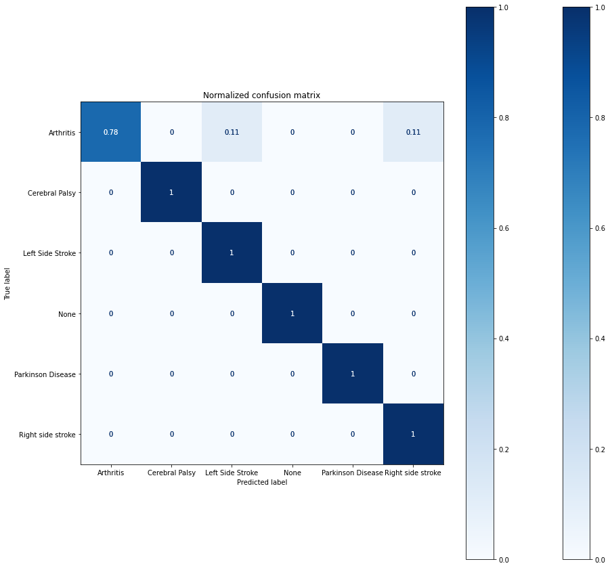
ML Training Results
From the confusion matrix
78% of Arthritis cases were predicted correctly.
100% of Cerebral palsy cases were predicted correctly.
100% of Left sided stroke cases were predicted correctly.
100% of Healthy cases were predicted correctly.
100% of Parkinson Disease cases were predicted correctly.
100% of Right sided stroke cases were predicted correctly.

Slide 18
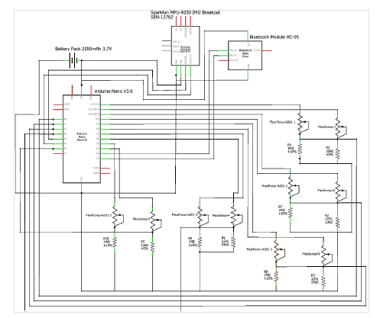
Proteus Circuit Design

Slide 19
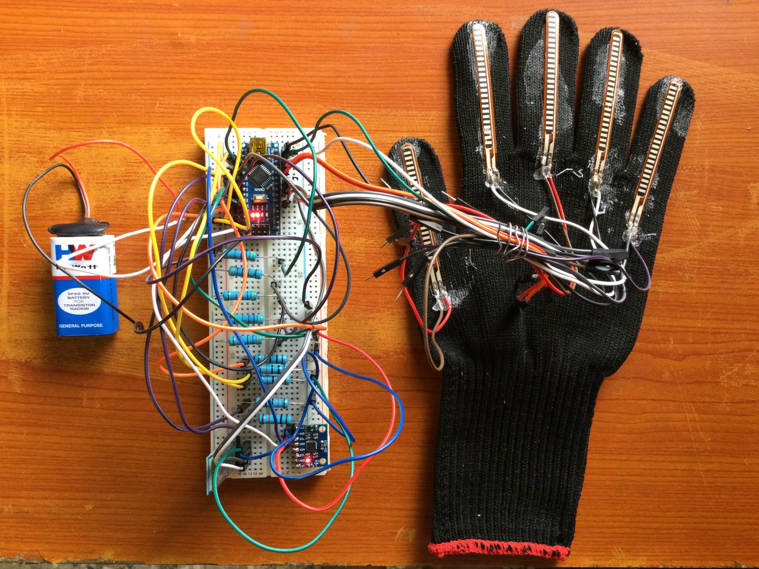
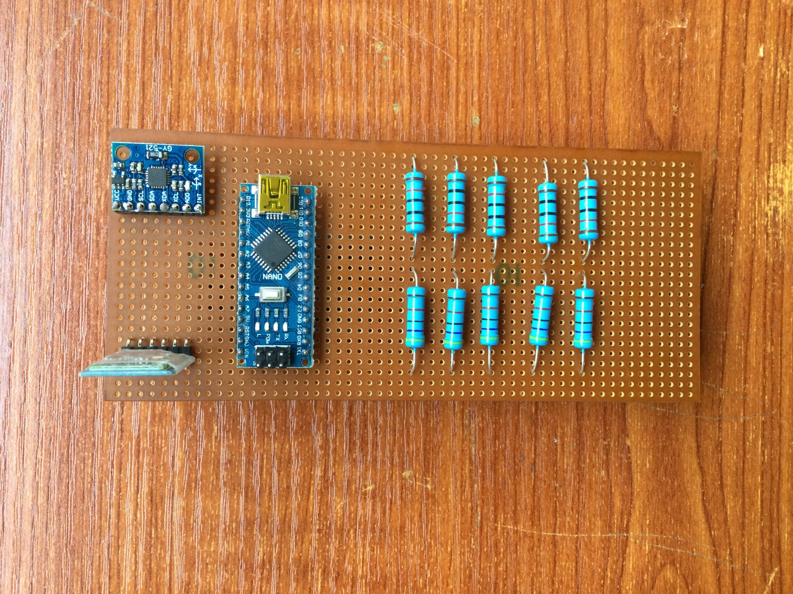
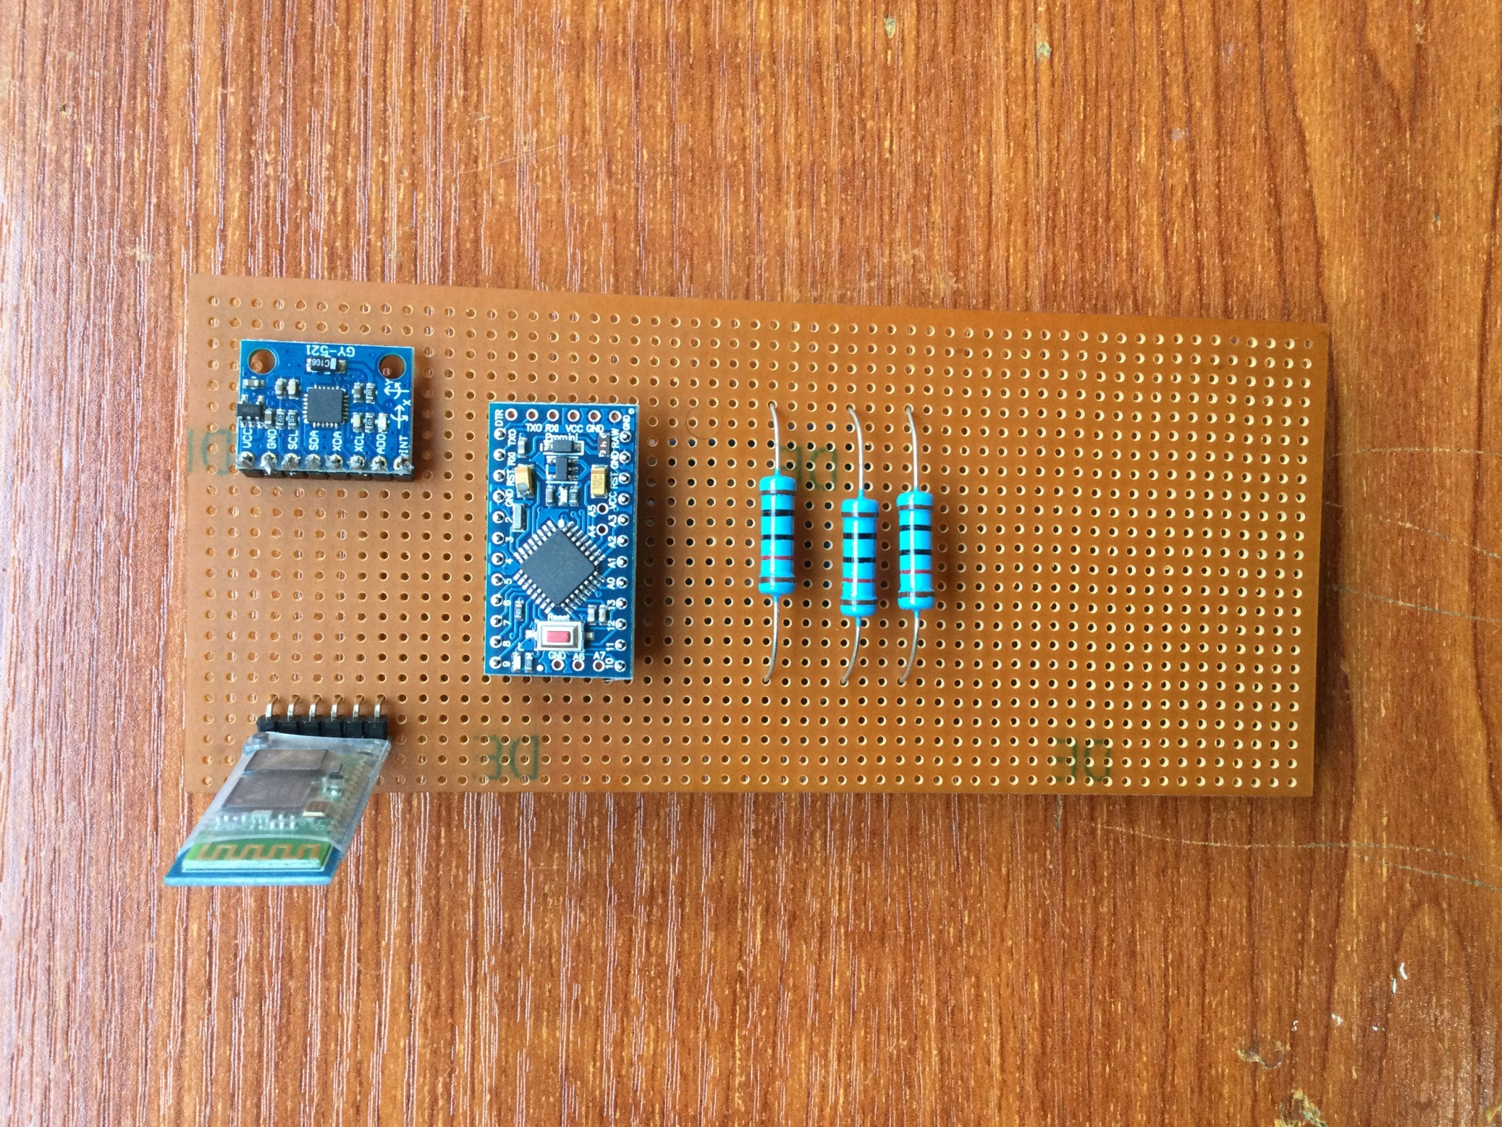
RESULTS
Veroboard Design
Breadboard Design

Slide 20
Challenges Encountered
Limitations of the Project
Delay on delivery of the electrical components required for the project.
Delivery of defective components.
Data extraction from the Arduino was slow due to the use of a Bluetooth module.
The quality of the results depends significantly on the quality of data extracted from the systems.
Data-driven mistakes such as noise and outliers could result in the inability to accurately measure, classify and predict physical impairment and disability.
Unavailability of data led to a small dataset, which may provide inaccurate predictions of new data. Small test data gave misleading results

Slide 21
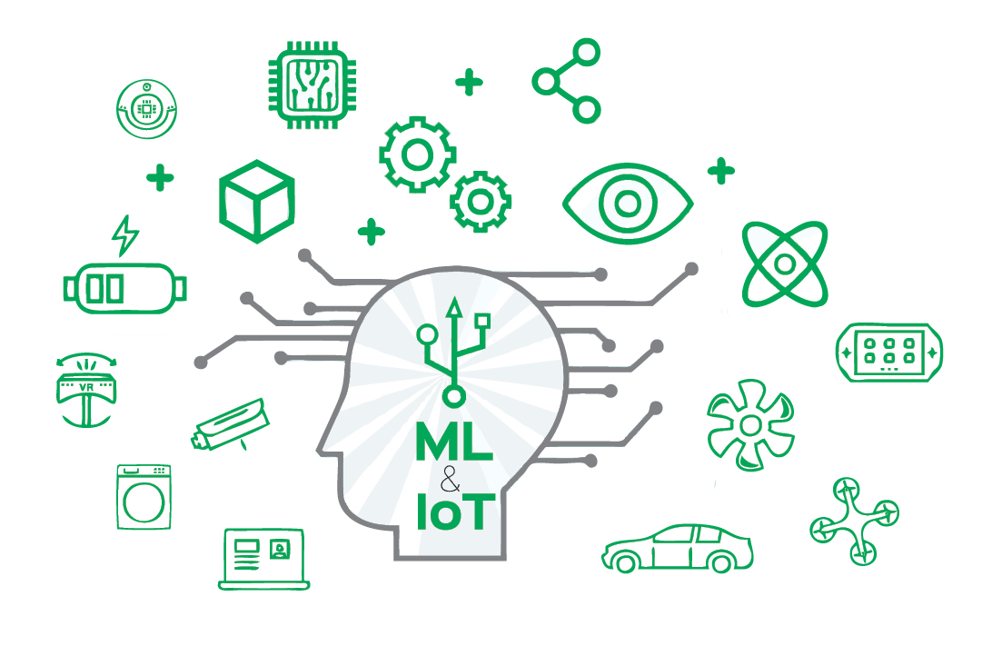
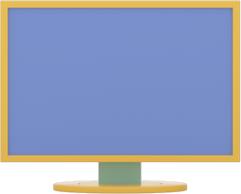
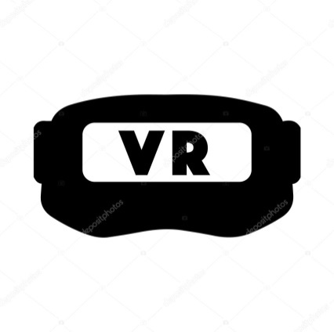
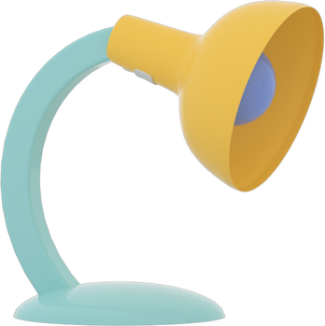
RECOMMENDATIONS
Providing physiotherapists remote access to monitor patients’ rehabilitation sessions and analysed data for aide in critical cases by building an e-health management dashboard.
Implementing Virtual Reality with serious games for more interactive and personalised user experience
Performing an extended study regarding the selection of the movements that are more appropriate for finger, hand and feet rehabilitation to allow for a greater variety of exercising plans.

Slide 22
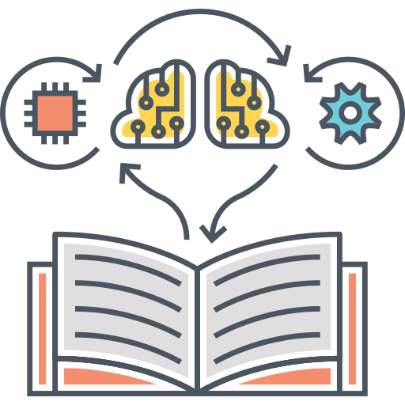
CONCLUSION
This project work satisfied its main aim of building a system for the physical rehabilitation of the upper and lower limbs in patients with motor disabilities, using a machine learning approach.
It provides a cheaper rehabilitation solution for patients with motor impairments to improve their motor function, thereby reducing recovery timeframes.

Slide 23
G. L. Krahn and D. Ph, “WHO World Report on Disability : A review,” Disabil. Health J., vol. 4, no. 3, pp. 141–142, 2011, doi: 10.1016/j.dhjo.2011.05.001
REFERENCES
K. Kietzmann, J., & Robson, “Introduction to The Internet of Everything : Connecting People , Things , and Data Minitrack,” 2016 49th Hawaii Int. Conf. Syst. Sci., p. (pp. 3918-3918). IEEE Computer Society., 2016, doi: 10.1109/HICSS.2016.728
M. Raad et al., “An IOT based wearable smart glove for remote monitoring of rheumatoid arthritis patients,” BIOSIGNALS 2019 - 12th Int. Conf. Bio-Inspired Syst. Signal Process. Proceedings; Part 12th Int. Jt. Conf. Biomed. Eng. Syst. Technol. BIOSTEC 2019, no. Biostec, pp. 224–228, 2019, doi: 10.5220/0007573302240228
O. Nave, C., Yang, Y., Viegas, V., & Postolache, “Physical Rehabilitation based on Smart Walker,” 2018 12th Int. Conf. Sens. Technol., p. (pp. 388-393). IEEE., 2018
P. MacEira-Elvira, T. Popa, A. C. Schmid, and F. C. Hummel, “Wearable technology in stroke rehabilitation: Towards improved diagnosis and treatment of upper-limb motor impairment,” J. Neuroeng. Rehabil., vol. 16, no. 1, 2019, doi: 10.1186/s12984-019-0612-y.
R. Alexandre, O. Postolache, and P. S. Girao, “Physical rehabilitation based on smart wearable and virtual reality serious game,” I2MTC 2019 - 2019 IEEE Int. Instrum. Meas. Technol. Conf. Proc., vol. 2019-May, 2019, doi: 10.1109/I2MTC.2019.8826947.

Slide 24
